Slide 1

WPDD202: Webpage Design & Development
Version 2 – 18th December 2015

Slide 2
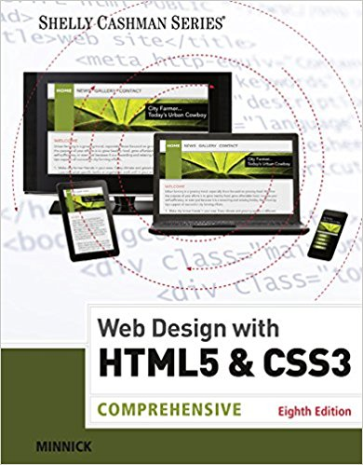
Resource Material
Web Design with HTML & CSS3: Comprehensive, 8th Edition
Jessica Minnick; Lisa Friedrichsen
ISBN-10: 1305578163 | ISBN-13: 9781305578166 © 2017
Cengage Learning Australia

Slide 3
Chapter 10
Creating Interactivity with Social Media and JavaScript

Slide 4
Chapter Objectives
Understand social media
Identify and describe forms of social media
Understand and describe a blog
Understand JavaScript
Describe JavaScript code
Understand and use the script element
Understand where JavaScript code may be written

Slide 5
Chapter Objectives (cont.)
Create an external JavaScript file
Describe pop-up windows
Understand and use the alert() method
Understand and use the open() method
Understand events
Use an onclick event handler

Slide 6
Using Social Media
Social Network
It is an online community where members post and exchange social media content
It allows members to share information and ideas with fellow online community members
It allows businesses to immediately connect with their customers and potential customers and instantly engage them with new product information

Slide 7
Using Social Media (cont.)
Facebook
It is a social networking site with more than one billion users
Users include individuals and businesses
A business can create a Facebook page and use it to advertise its products and services
Individuals can “like” a business by clicking a button to indicate that they use or approve of a produce
Obtaining “likes” is a goal for most businesses, as this increases its presence and positive perception

Slide 8
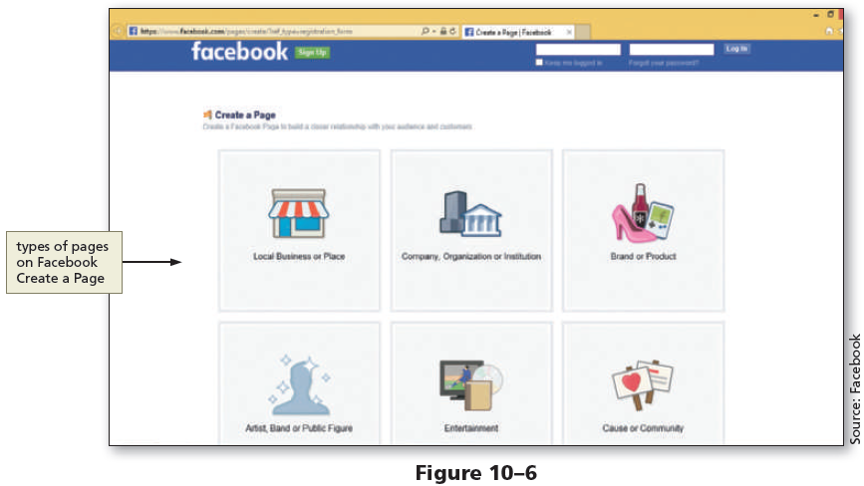
Using Social Media (cont.)

Slide 9
Using Social Media (cont.)
Twitter
It is a social networking site used to post short comments or updates
Each post, known as a tweet, is limited to 140 characters
Customers have the option to follow a business on Twitter
It provides marketing opportunities for business to help with a content strategy, to engage and obtain more customers, and to measure marketing results in real time

Slide 10
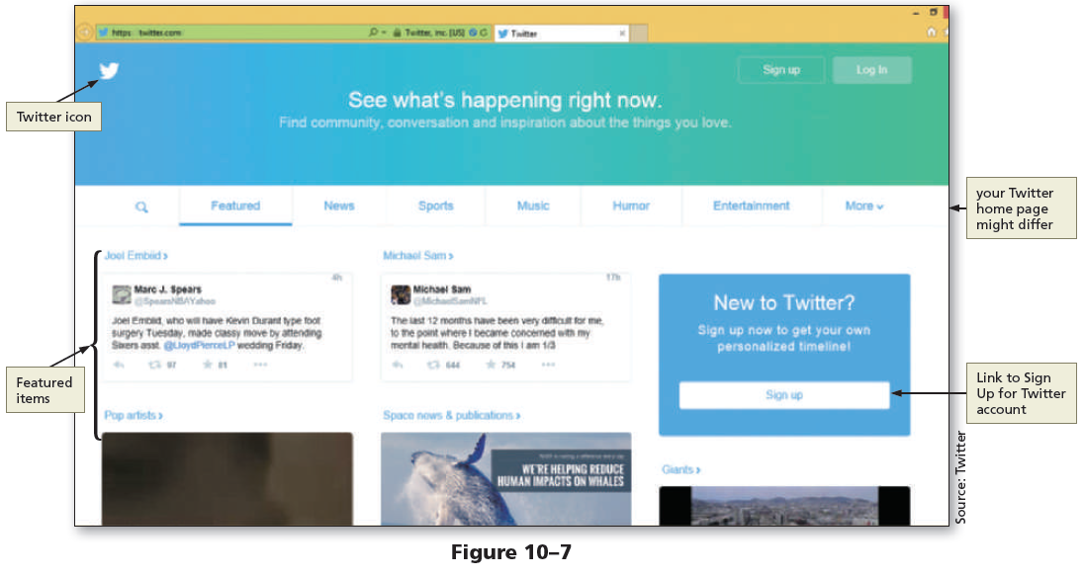
Using Social Media (cont.)

Slide 11
Using Social Media (cont.)
Google+
A Google account is required to use it which can be created for free at plus.google.com
Once an account is established, people are added to circles
Circles are groups or categories, such as friends, family, and acquaintances

Slide 12
Using Social Media (cont.)
Google+
Businesses use Google+ to post special offers and pictures of new products to share with their customers
Businesses have an added benefit because Google+ works with Google’s search engine, increasing the probability of a potential customer finding the business through Google’s search engine

Slide 13
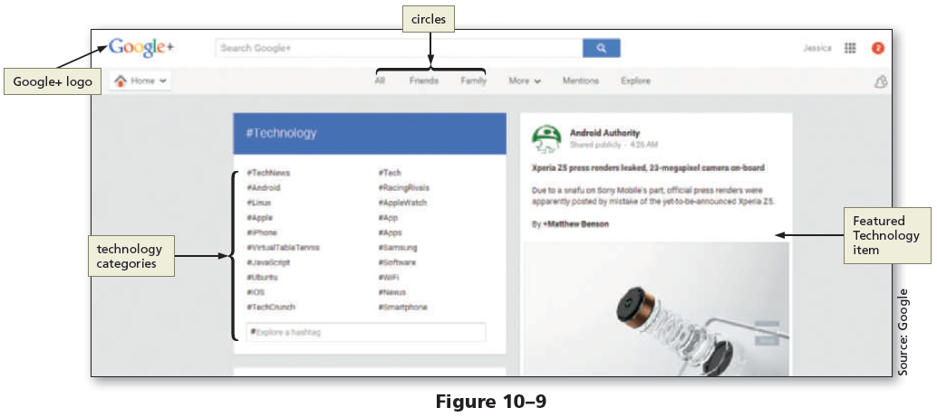
Using Social Media (cont.)

Slide 14
Using Social Media (cont.)
YouTube
It is a social media website where members can upload and share original videos and subscribe to a channel
Businesses purchase ad space on YouTube to attract its target audience or create their own channel and upload videos
Business ads can be a banner image that is displayed on the lower part of a video or a full-length commercial that plays before the selected video

Slide 15
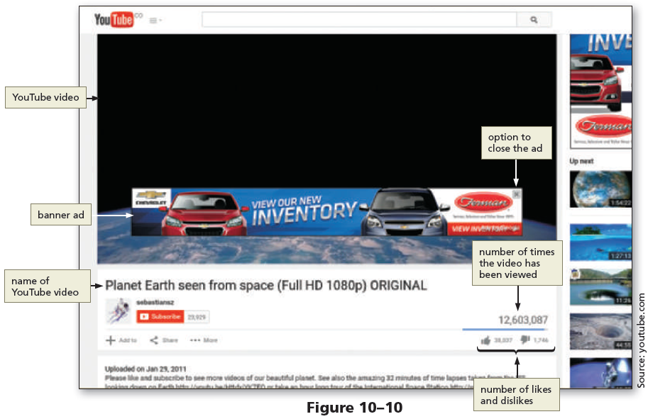
Using Social Media (cont.)

Slide 16
Using Social Media (cont.)
Instagram
It is a social networking site where members can upload and share photographs, images, and video
It allows users to connect and express ideas with captivating visual photography
The free app allows users to apply various filters to enhance photographs, images, and video
Businesses use it to promote brand awareness

Slide 17
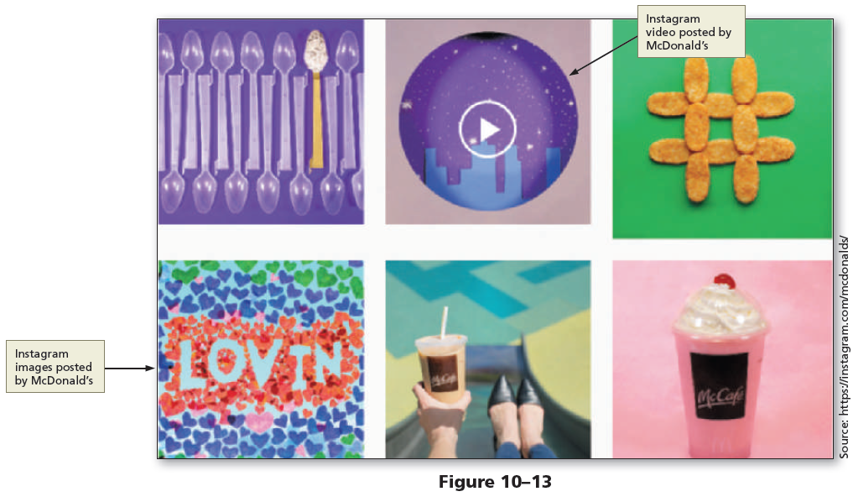
Using Social Media (cont.)

Slide 18
Using Social Media (cont.)
Pinterest
It allows members to browse and “pin” ideas found on the web
Users search for ideas for just about anything, including recipes, crafts, photography, and do-it-yourself (DIY) projects
They can follow boards that interest them most and “pin” photos, links, and comments to their own board for future use

Slide 19
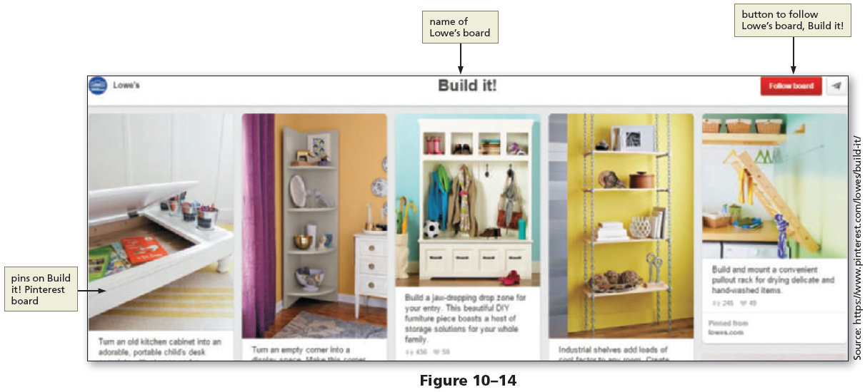
Using Social Media (cont.)

Slide 20
Using Social Media (cont.)
Other Social Media Options
Other social media options for a business to explore include LinkedIn, Quora, Tumblr, StumbleUpon, Flickr, Delicious, Digg, Vine, Foursquare, and many more
The key is to determine which social media outlets are best for a business in attracting new customers
A business owner must also consider the time involved with keeping the social media current and relevant

Slide 21
Using Social Media (cont.)
Blogs
Are online journals, maintained by individuals, groups, or businesses
“Blog” is short for a combination of the words web and log
Businesses use them to share new information and to keep their customers engaged
Business owners who maintain blogs should respond to customer comments on time and keep their blog content fresh

Slide 22
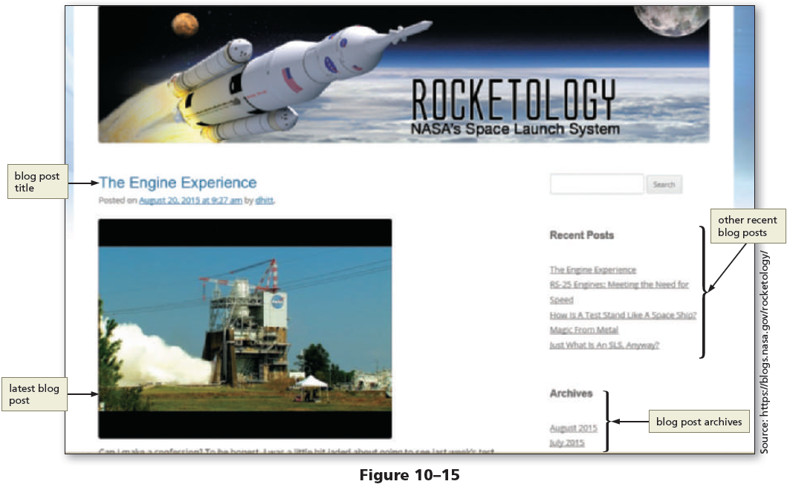
Using Social Media (cont.)

Slide 23
Using Social Media (cont.)
Adding Facebook and Twitter Links to a Website
Businesses that use social media display social media icons and links on their website, which lets their customers know how to connect with the business on social media
When users click a social media icon, they are redirected to the social media page for the business
Social media links are typically included near the top or bottom of a webpage

Slide 24
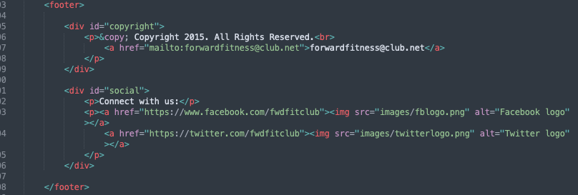

To Add Social Media Icons and Links to the Home Page
Figure 10–20 shows how to add social media icons and links to a Home Page
Filename: index.html

Slide 25
Incorporating JavaScript
JavaScript
It is a scripting language that provides various types of functionality to webpages, such as the ability to interact with the user
Web developers use it to control webpages
It is a client-side scripting language, which means that the browser interprets and renders the JavaScript

Slide 26
Incorporating JavaScript (cont.)
JavaScript
Many mobile websites integrate an icon commonly called the hamburger icon for use as a menu button
The hamburger icon consists of three, horizontal, parallel lines and uses JavaScript to display a menu and allow users to select an option

Slide 27
JavaScript Terminology
An object in JavaScript is programming code and data that can be treated as its own entity
JavaScript objects have properties and methods
Properties are attributes that describe an object’s characteristics

Slide 28
JavaScript Terminology (cont.)
As shown in the following example, an object name and its property are separated by a period
myForm.fname.style.backgroundColor=“#ff0000”
browser=chrome.appName
A value can be assigned to a property, or a property can return a value
An object can be a property of a superior object
Object name
Object’s property

Slide 29
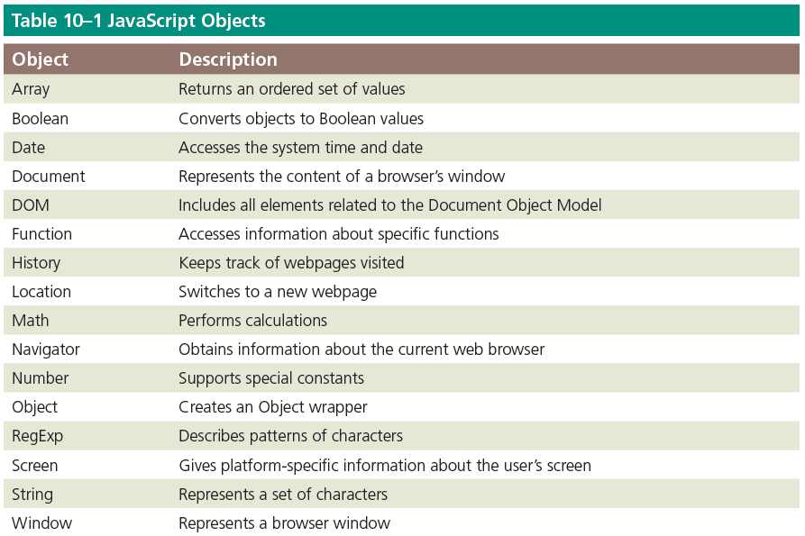
JavaScript Terminology (cont.)
Table 10–1 contains a general list of the built-in JavaScript objects common to many browsers

Slide 30
JavaScript Terminology (cont.)
Methods
They are actions that an object can perform
Methods associated with the document object might be write and open
An object and one of its methods would be written as follows:
document.write()
where document is the object and write is a method of the document object
They are followed by parentheses, which may be empty or may contain an argument

Slide 31
JavaScript Terminology (cont.)
Argument
It is a value given to a method
Some methods require arguments, and others do not
Example:
document.write(“Good Morning”)
In this case, the argument “Good Morning” describes the text content to display on the document

Slide 32
JavaScript Terminology (cont.)
Function
It is a set of JavaScript statements that perform a specific task
It must include a name and statements that specify a task to be performed
Example:
function myFunction () {
statement 1;
statement 2;
statement 3;
}

Slide 33
JavaScript Terminology (cont.)
Variable
It is a container that holds a value
JavaScript uses variables to store values temporarily in internal memory
A variable’s value can change, depending on the results of an expression or data entered by a user in a form
Variables must have a unique name and must follow the same naming conventions as user-defined functions

Slide 34
JavaScript Terminology (cont.)
Event handler
Is used by JavaScript to associate an action with a function
An event is the result of an action, such as a mouse click
JavaScript event handlers make webpages more dynamic and interactive by allowing JavaScript code to execute only in response to a user action

Slide 35
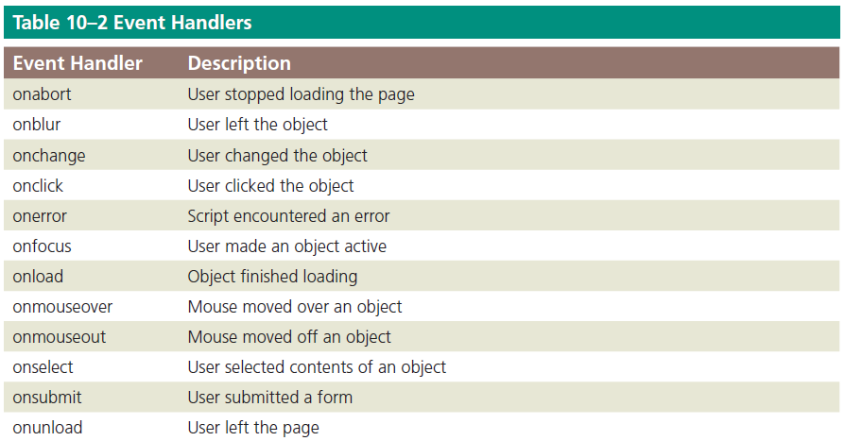
JavaScript Terminology (cont.)
Table 10–2 lists common event handlers

Slide 36
Writing JavaScript Code
The following syntax rules and guidelines should be followed when writing JavaScript code
JavaScript is case sensitive
One-line comment and multiline comments are written as follows:
// Single line comment syntax
/* Multiple line
comment syntax */
Semicolons are used to end JavaScript statements

Slide 37
Writing JavaScript Code (cont.)
JavaScript can be written within an HTML page or as a separate JavaScript file with the filename extension .js
When written within an HTML page, the code may be within the head element or the body element
When created as an external .js file, place a script element in the head element of the HTML file and specify the external .js file as the file source shown as follows:
<script src="scripts/myfunction.js"></script>

Slide 38
Pop-up Windows
JavaScript is commonly used to create a pop-up window
Pop-up windows are a quick and simple way to add interactivity and capture user attention
To add a pop-up window to an HTML page, use the script tags and place the JavaScript code within the script element
The three types of pop-up windows in a webpage are alert box, confirmation box, and prompt box

Slide 39
Pop-up Windows (cont.)
Alert box
Is used to display a message
This can be useful for a business to grab the user’s attention with information about a special promotion.
To create an alert box, use the alert() method
Example of an alert box code is as follows:
<script>
alert("Receive a 20% discount today!");
</script>

Slide 40
Pop-up Windows (cont.)
Confirmation box
It is used to confirm the user’s action using the confirm() method
Example:
<script>
if(confirm("Do you wish to proceed?")) {
alert("You selected OK");
} else {
alert("You chose to Cancel");
}
</script>

Slide 41
Pop-up Windows (cont.)
Prompt box
It captures information from a user and performs an action with it and is created using the prompt() method
Example of a prompt box code is as follows:
<script>
var name = prompt("What is your name?");
if (name != null) {
alert("Hello " + name);
} else {
alert("You did not tell me your name. ");
}
</script>

Slide 42
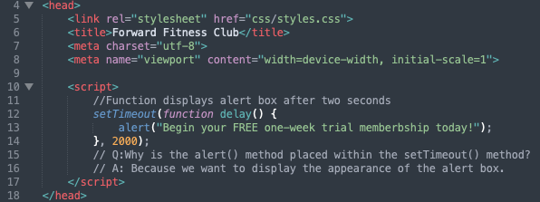
To Add a Pop-up Window to the Home Page
Figure 10–36 shows how to add a pop-up window to the home page
Filename: index.html

Slide 43
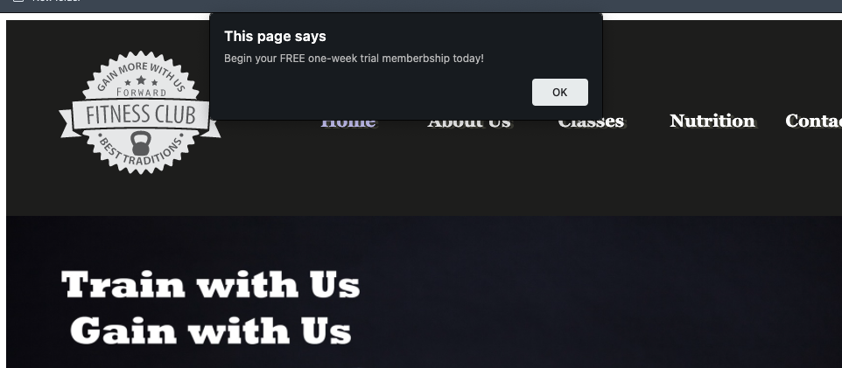
To Add a Pop-up Window to the Home Page (cont.)
Figure 10–37 shows the pop-up window on the home page

Slide 44
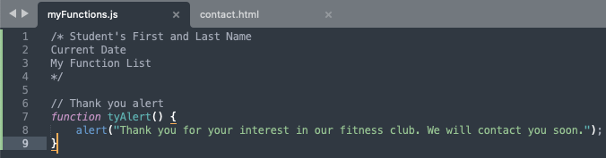
To Create a Function in an External JavaScript File
Figure 10–39 shows the code to create a function in an external JavaScript file
Filename: myFunctions.js

Slide 45
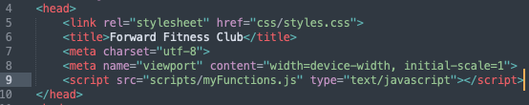
To Call a JavaScript Function
Figure 10–40 shows the code to insert a script element
Filename: contact.html

Slide 46
To Call a JavaScript Function (cont.)
Figure 10–41 shows the code to insert an event handler
onclick event handler
Filename: contact.html

Slide 47
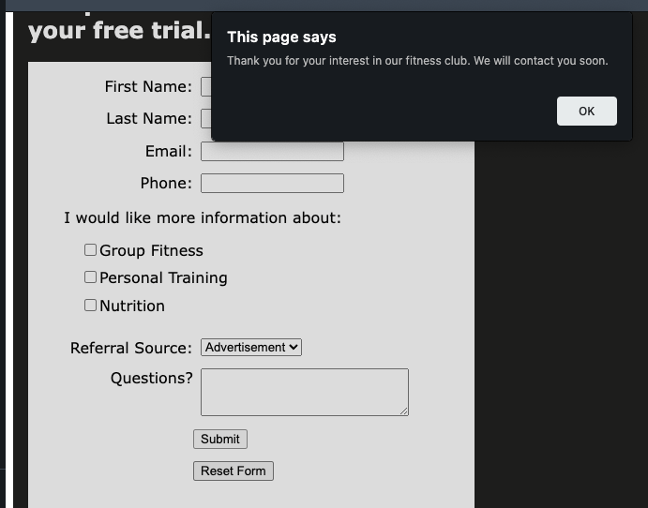
To Call a JavaScript Function (cont.)
Figure 10–42 shows the output when the Submit button is clicked to trigger the onclick event handler

Slide 48
The open() Method
open()method
It is used to open a new browser window
Example:
window.open("http://www.cengage.com", "_blank", "width=400, height=400");
In this example, a new window opens to the Cengage.com home page
The _blank specifies to open the webpage in a new window
The width and height of the new window are set to 400 pixels

Slide 49
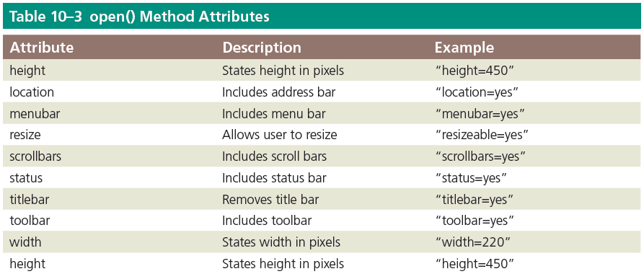
The open() Method (cont.)
Table 10–3 lists commonly used attributes of the open() method, which are used to define pop-up window features

Slide 50

A Short Academic-Integrity Presentation
What do we mean when we say "academic integrity"?
What are the 3 main kinds of academic misconduct?
What happens when we break academic integrity rules?
Common problem #1: paraphrasing
Common problem #2: citations
Common problem #3: quoting too much
A quiz! Of course there's a quiz.

Slide 51
A Short Academic-Integrity Presentation
What do we mean when we say "academic integrity"?
Being honest in your dealings as a student
Being ethical
Maintaining the value of higher education
Maintaining the quality of courses and learning experiences

Slide 52

A Short Academic-Integrity Presentation
2. What are the 3 main kinds of academic misconduct?
Contract cheating – asking/paying another person to create all or parts of an assessment and saying that it’s your own.
Using other people’s work (especially that of published researchers) without quoting, citing, and/or referencing accurately. This is plagiarism.
Using other people’s work, but not changing it sufficiently (e.g. not paraphrasing completely). This is also plagiarism.

Slide 53



A Short Academic-Integrity Presentation
3. What happens when we break academic integrity rules?
The percentage of your assignment that is plagiarised will not be assessed (~ % penalty).
Zero for the assessment in serious cases.
3. Zero for the unit in more serious cases.

Slide 54
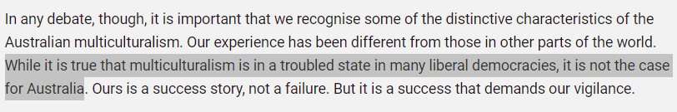
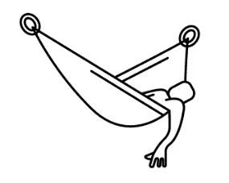


A Short Academic-Integrity Presentation
4. Common problem #1: lazy paraphrasing
Original:
Lazy
Studious
It is fact that multiculturalism is in a bad state in many countries, but it is not the situation in Australia (Australian Human Rights Commission 2016).
As the Australian Human Rights Commission (2016) points out, Australia does not have the problems with multiculturalism that many other liberal democracies have.
This is plagiarism

Slide 55
A Short Academic-Integrity Presentation
5. Common problem #2: citations
Author(s) family names
Space, no comma
Full stop after (not before)
(Taylor & Harrison 2016).
Parenthesis, no space before or after
Parenthesis, no space after
Year of publication

Slide 56
A Short Academic-Integrity Presentation
5. Common problem #2: citations for quotes
p, full stop, and a space
(Taylor & Harrison 2016, p. 11).
The page number
Comma and space

Slide 57
A Short Academic-Integrity Presentation
6. Common problem #3: quoting too much
According to the Australian Human Rights Commission (AHRC) (2016, p 16), ‘it is important that we recognise the some of the distinctive characteristics of Australian multiculturalism’. This is because ‘our experience has been different from those in other parts of the world’ (AHRC 2016, p 16). The AHRC (2016, p 16), claims that ‘ours is a success story, not a failure’, but that ‘it is a success story that demands our vigilance’.
Can you see the problem here?
Notes:
The problem here is that very little – basically none – of the discussion in this paragraph is original. The student hasn’t offered any insight, analysis, explanation, critique, exemplification or anything else that makes these ideas meaningful in the content of the assignment. Because so much of this is unoriginal, it can be seen as approaching plagiarism.

Slide 58
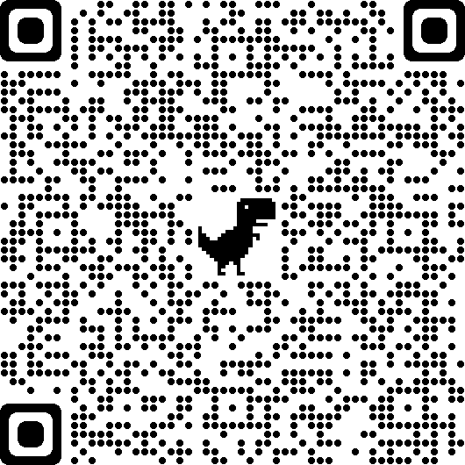
A Short Academic-Integrity Presentation
7. A quiz.
Link

Slide 59
A Short Academic-Integrity Presentation
Come and visit us at Academic Learning Support (ALS) for more help with academic integrity or any other learning matter.
Drop-in hours: 10AM-11AM and 2PM-3PM, Monday to Friday
ALS Melbourne
ZOOM: 713 695 7302
TEL: (03) 8353 0871
ALS Sydney
ZOOM 658 953 2737
TEL: (02) 9092 5171

Slide 60

kent.edu.au Kent Institute Australia Pty. Ltd. ABN 49 003 577 302 ● CRICOS Code: 00161E ● RTO Code: 90458 ● TEQSA Provider Number: PRV12051

